Slide 1

SERS-Based Nanobiosensor Workflow for Sepsis Diagnostics

Slide 2

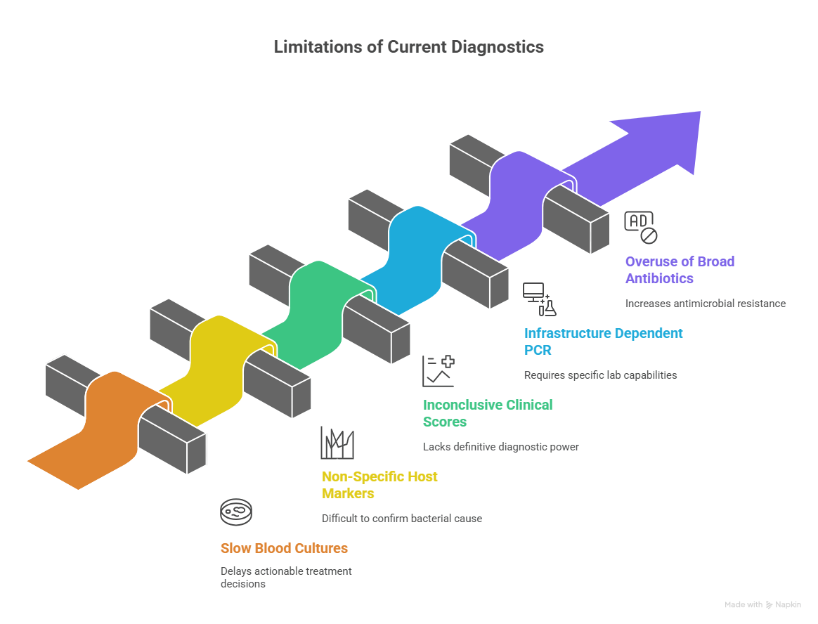

Clinical Urgency of Sepsis
• Approximately 49 million sepsis cases globally (2020) with ~11 million deaths.
• Early detection and treatment are critical; delays increase mortality.
• Sepsis is a major contributor to hospital fatalities and ICU burden.
Limitations of Current Diagnostics

Slide 3

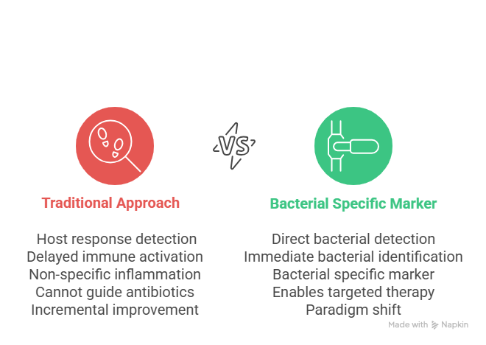
Why Bacterial-Specific Biomarkers?
Early diagnosis and improved clinical outcomes.
Directly indicate the presence of bacteria (not just host inflammation).
Enable Gram classification. Reduce unnecessary broad-spectrum antibiotic use and combat AMR.

Slide 4


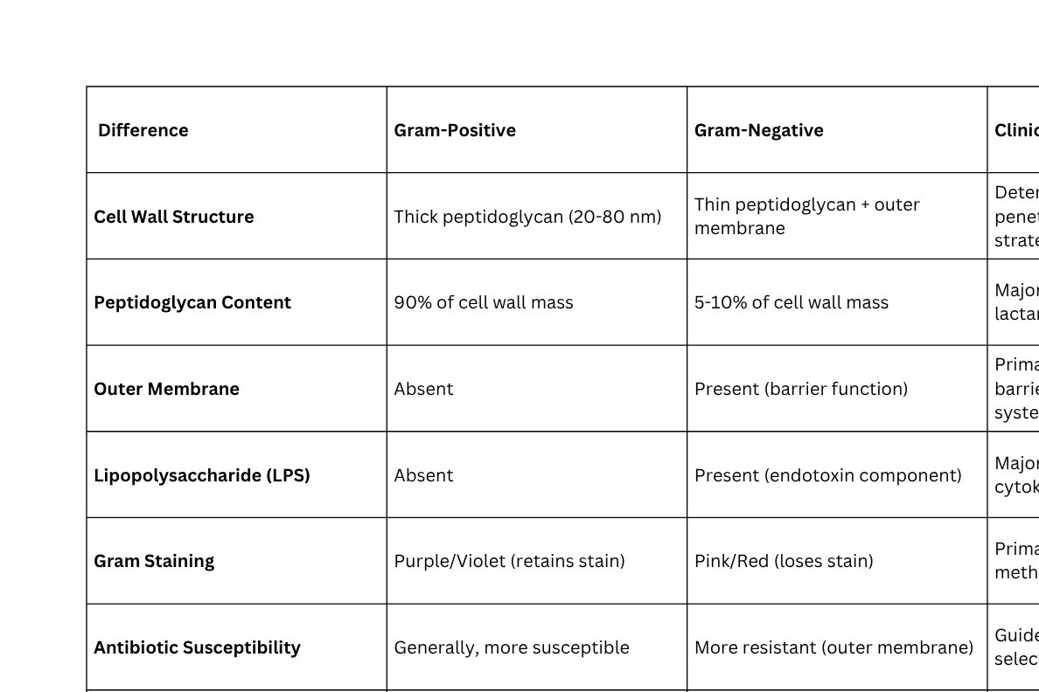

Slide 5
Proposed Bacterial Biomarkers panel
Universal Bacterial Detection: Peptidoglycan fragments (N-acetylmuramic acid)
Reason : Present in ALL bacteria, absent in viruses/fungi/parasites . Direct bacterial confirmation.Unique to bacterial peptidoglycan only.
Gram-negative: Lipopolysaccharide (LPS) — lipid A & O-antigen .
Reason :present Only in Gram-negative bacteria, absent in all other organisms.Strong enhancement, endotoxin correlation
Gram-positive: Lipoteichoic acid (LTA) and wall teichoic acids (WTA).
Reason : present Only in Gram-positive bacteria , surface accessibility

Slide 6
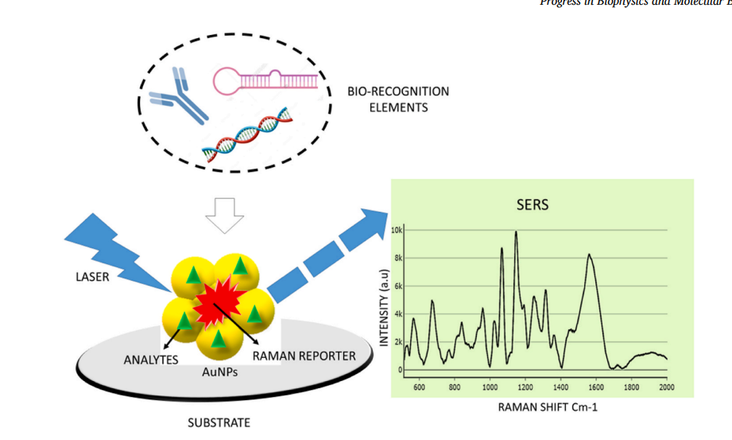
SERS Nanobiosensor: Overview
• SERS = Surface-Enhanced Raman Spectroscopy; provides molecular fingerprints.
• Plasmonic nanostructures (Ag/Au) create strong local fields (hotspots).
• Combine SERS substrate with capture probes (aptamers/antibodies) for selectivity.
SERS Fundamentals
• Raman scattering measures vibrational modes; specific peaks = molecule signature.
• Electromagnetic enhancement from plasmon resonance scales..
• Hotspots (nanogaps) give the largest enhancement; single-molecule sensitivity possible.

Slide 7
Nanomaterials & Substrate Design
• Choice of metal (Ag stronger SERS; Au more stable) affects resonance.
• Particle geometry (stars, rods, gaps) tunes hotspot intensity.
• Substrate uniformity & reproducible fabrication are essential for clinical use.
Excitation Wavelength & Practical Considerations
• Common lasers: 532 nm (resonant dyes), 633 nm, 785 nm (bio-friendly), 1064 nm (high autofluorescence samples).
• Balance: stronger scattering (shorter λ) vs. fluorescence/background and sample heating.
• Laser power and exposure time must be optimized for clinical samples.

Slide 8
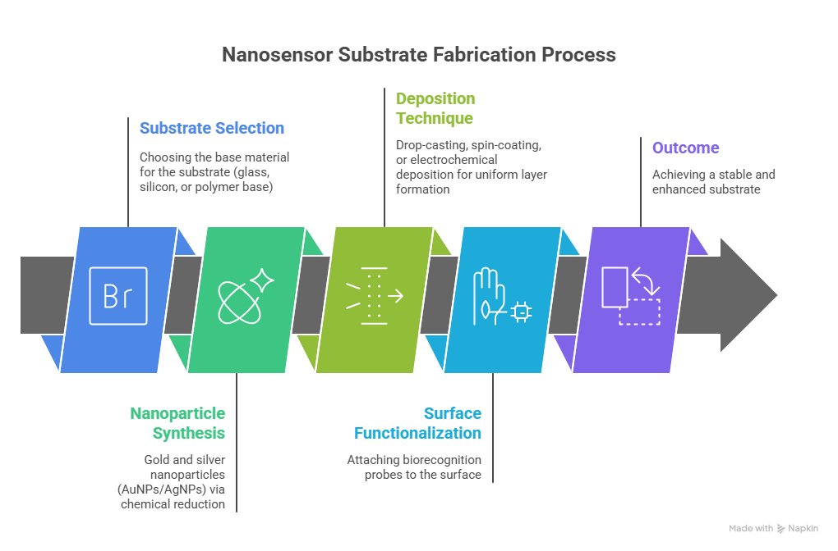
Objective: To develop a reproducible plasmonic substrate with strong Raman enhancement for bacterial biomarker detection (LPS, LTA, PGN).

Slide 9
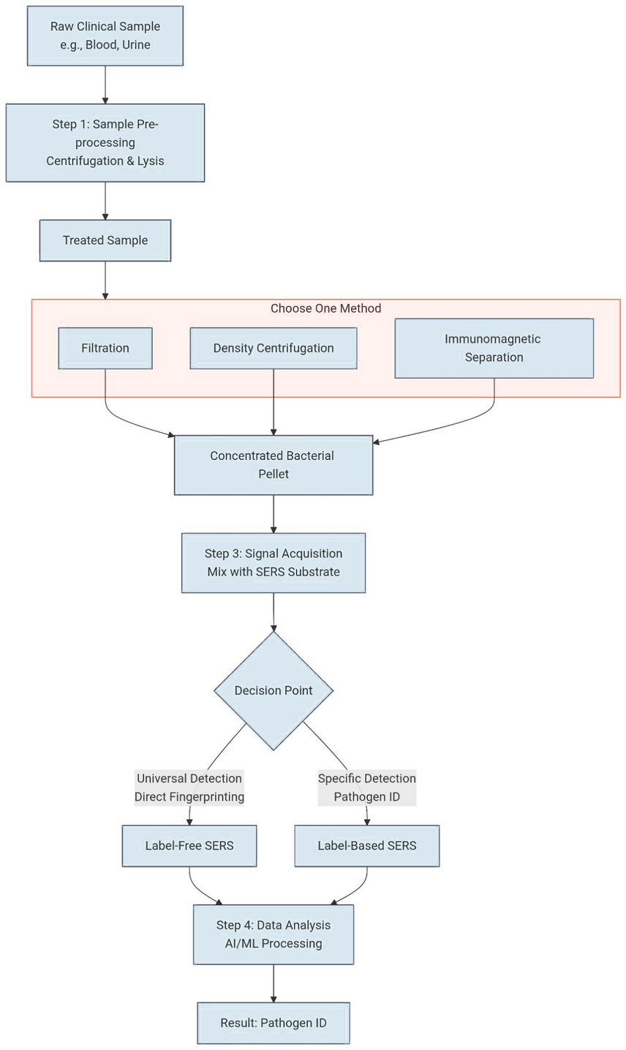
Workflow
Pipeline:

Slide 10
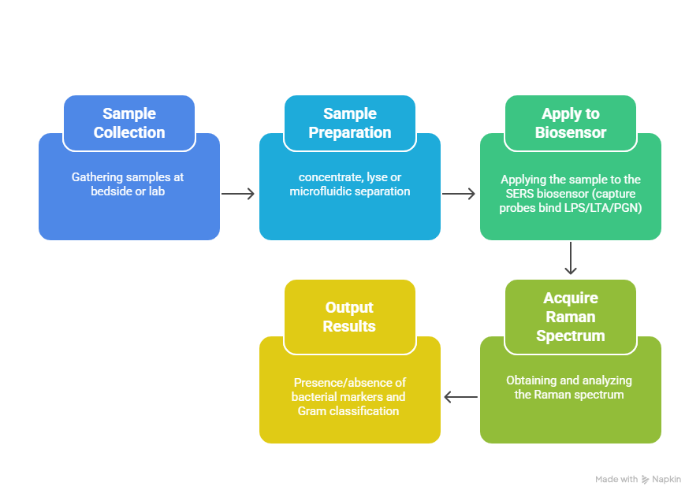
Diagnostic Workflow (Patient → Answer)

Slide 11
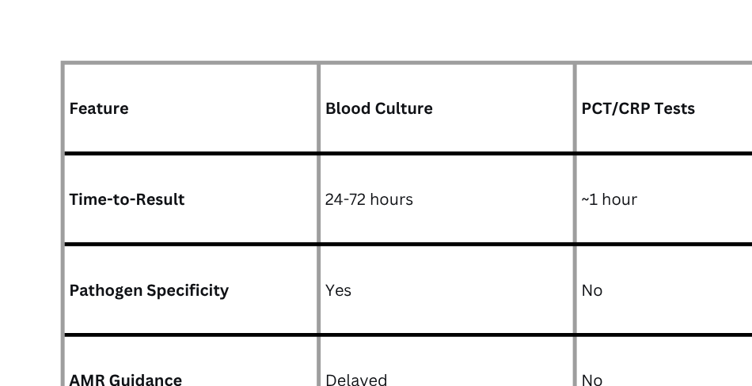
Competitive Advantage & Market Differentiation :
Key Message: With the help of this project we envision to bridge the gap between speed and specificity

Slide 12

Clinical Utility & Impact
• Rapid Gram-level info enables earlier targeted antibiotics (improves survival).
• Less empiric broad-spectrum use → supports antimicrobial stewardship.
• Portable SERS devices can enable near-patient, point-of-care testing in ED/ICU.
Challenges & Roadmap
Extensive literature review done and finalization of biomarker process .
SERS simulations initiation to optimize spectral response and substrate design.
Next: experimental validation of simulation results using standard samples.
Prototype fabrication and spectral benchmarking planned in next phase.
Key challenges: ensuring signal reproducibility, substrate uniformity, and scaling for real-world use.
Long-term goal: translate optimized SERS workflow into a portable sepsis diagnostic device.

Slide 13
References
1. Singer M. et al., The Third International Consensus Definitions for Sepsis and Septic Shock (Sepsis-3). JAMA. 2016.
2. Kundu A. et al., SERS detection of sepsis biomarkers on Ag–BP platform. Sensors/Diagnostics, 2022.
3. Hung S. K. et al., Current Evidence and Limitations of Biomarkers for Detecting Sepsis. Biomedicines, 2020.
4. Hassan M. et al., Advances in Bacterial Detection Using SERS. Biosensors (2024).
5. Raetz CRH, Whitfield C., Lipopolysaccharide endotoxins. Annu Rev Biochem. 2002.
6. NICE Guideline NG51, Sepsis: recognition, diagnosis and early management. 2017.
7. Recent reviews on sepsis biomarkers and SERS-based diagnostics (2023–2025).
8.Evans L, et al. Crit Care Med. 2021;49(11):e1063-e1143.
10.He R‑R, et al. Sepsis biomarkers: advances and applications. IJMS 2024
9.Wang A, et al. Chem Soc Rev. 2024;53:1108-1132.
11.Langer J, et al. ACS Nano. 2019;14(1):28-117.
12,Karmacharya et al., “Nanoplasmonic SERS on Fidget Spinner for Digital Bacterial Identification,” Microsyst. Nanoeng., 2025
13.Kundu A. et al., “Ultrasensitive and Label-Free Detection of Prognostic and Diagnostic Biomarkers of Sepsis on a AgNP-laden Black Phosphorus–Based SERS Platform,” Sensors & Diagnostics, 2022.

Slide 14
Thank
You

